Slide 1

Hostel Hunt
Presented By
Kaushal Sharma 248039
Umesh Patil 248104
Guided By:-
Mr. Prithviraj Shinde

Slide 2
1. Introduction
The Hostel Hunt System is a web-based application designed to simplify the management of hostels by providing an efficient platform for hostel owners, administrators, and users (students, travelers, or tenants). The system enables hostel owners to list their properties, users to book rooms, and administrators to oversee all operations.

Slide 3
2. Objectives
The primary objectives of the Hostel Hunt System are:
To provide an online platform for hostel booking and management.
To ensure a seamless and user-friendly experience for hostel owners and tenants.
To automate hostel-related activities, such as room booking, payments, and inquiries.
To provide a secure and efficient payment system.
To enable administrators to manage users, bookings, and hostel approvals efficiently.

Slide 4



3. User Classes
User
Admin
Owner
In this module a User will register, update details from various hostels available.
In this module Admin can manage User and Owner. Will maintain one to one relation.
In this module Owner can register , login and can upload their Hostel details.

Slide 5
4. Architecture
A. Frontend:
HTML/CSS, ReactJs (for web application).
Forms for login, and hostel management.
B. Backend:
Core Java for business logic.
Spring Boot for handling requests.
C. Database:
MySQL for storing:
User profiles
Hostel data
Booking details
D. APIs:
Use APIs for:
Location services (Google Maps).
Payment gateways.

Slide 6
5. Technologies
Frontend: HTML/CSS, ReactJs.
Backend: Core Java, Spring Boot.
Database: MySQL.
APIs: Google Maps API, Payment Gateway API.

Slide 7
6. System Features
6.1 User Features
User registration and login.
View hostel details, including room availability, pricing, and facilities.
Book hostel rooms and make payments online.
View booking history and transaction details.
Cancel bookings if needed.

Slide 8
6. System Features
6.2 Owner Features
Register and log in as an owner.
Add, update, and manage hostel listings.
Set room availability and pricing.
View and manage user bookings.
Respond to user inquiries.

Slide 9
6. System Features
9
6.3 Admin Features
Manage users and owners.
Approve or reject hostel listings.
Monitor bookings and payments.
Generate reports on hostels, users, and transactions.

Slide 10
6. System Features
10
6.4 Payment System
Secure payment gateway integration.
Support for multiple payment methods (credit/debit card, UPI, net banking).
Automated payment status updates

Slide 11
7. Sample Workflow
11
User signs up and logs in.
Searches for hostels in a specific city.
Views the list of results with filters applied.
Selects a hostel and views details.
Books the hostel or adds it to favorites.
Leaves a review after the stay.

Slide 12
8. Software Requirement
Software Requirement
12
8.1 Functional Requirements
User registration and authentication system.
Search and filter hostels based on various parameters.
Booking functionality with real-time availability updates.
Secure payment processing via payment gateway.
Review and rating system for users.
Hostel listing management for owners.
Admin dashboard for managing users, bookings, and approvals.

Slide 13
8. Software Requirement
13
8.2 Non-Functional Requirements
Scalability: The system should handle multiple concurrent users without performance degradation.
Security: Secure authentication and payment transactions with encryption protocols.
Performance: Fast and responsive UI with optimized backend processing.
Reliability: High availability to ensure minimal downtime.
Usability: Intuitive UI/UX for easy navigation and interaction.

Slide 14
8. Software Requirement
14
8.3 Software Interfaces
Software Configuration for Back-end Services:
Java EE
Spring Boot, JPA, Razor Pay, Spring Authentication
MySQL
STS 4

Slide 15
8. Software Requirement
15
8.3 Software Interfaces
Software Configuration for Front-end Services:
ReactJS, Swagger
HTML, CSS, JS
Bootstrap

Slide 16
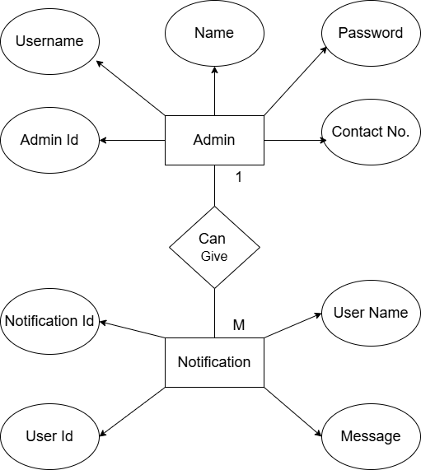
9. Diagram
16
9.1 ER Diagram

Slide 17
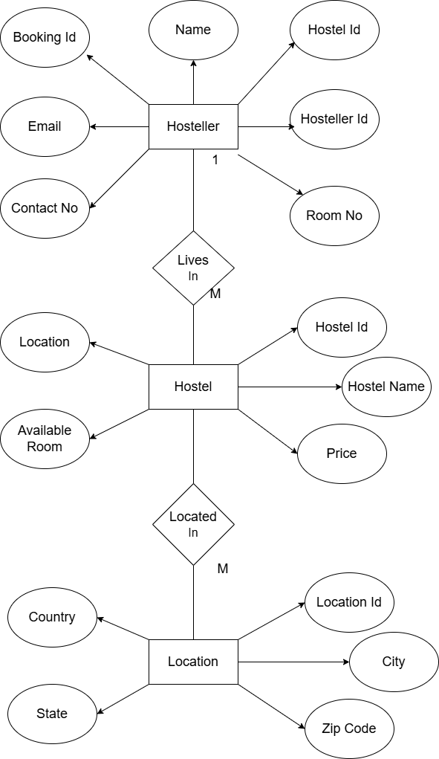
9. Diagram
17

Slide 18
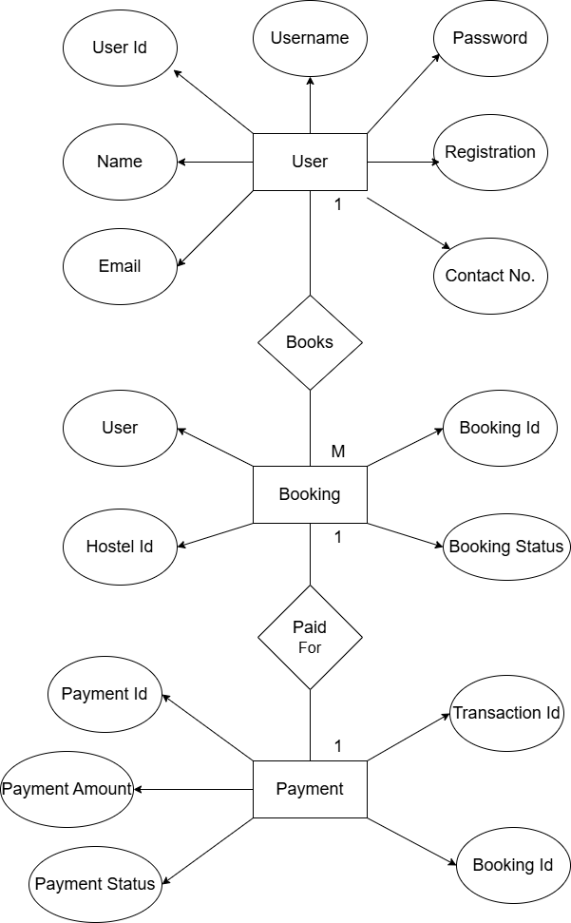
9. Diagram
18

Slide 19
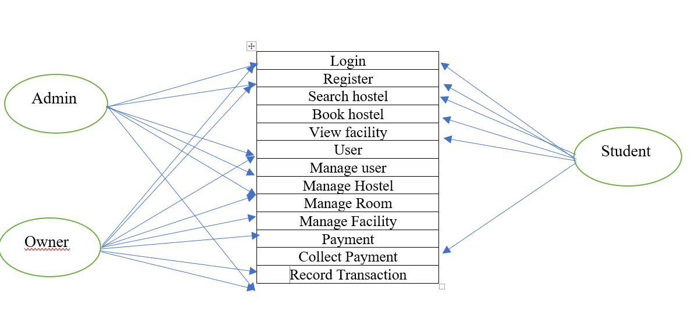
9. Diagram
19
9.2 Use Case Diagram

Slide 20
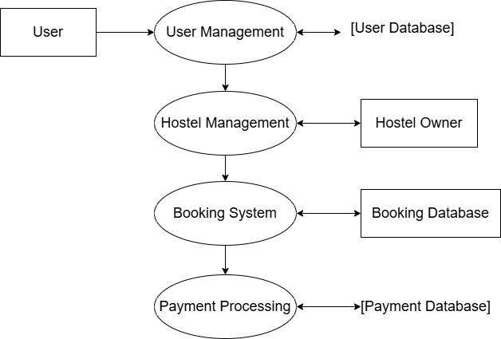
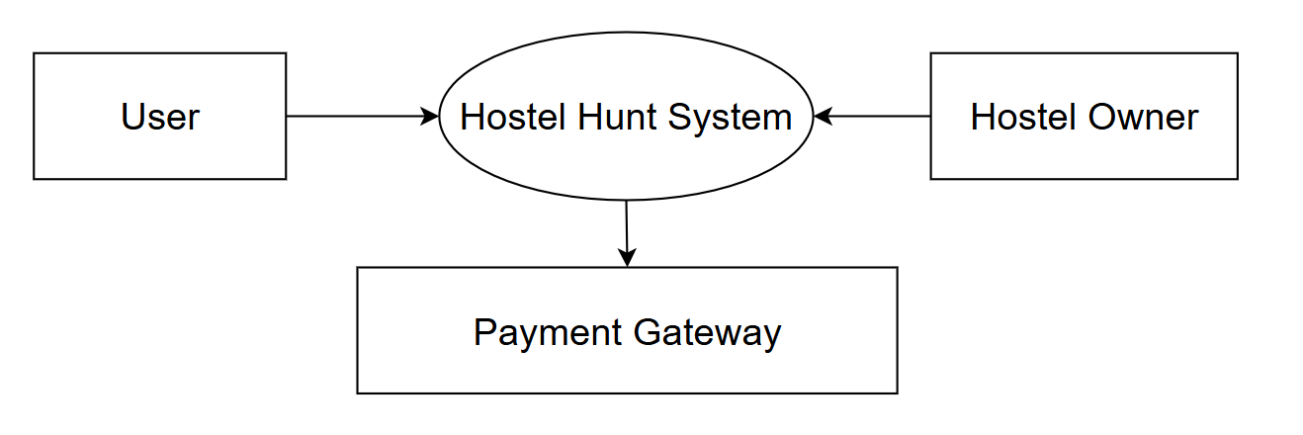
9. Diagram
20
Data Flow Diagram-1
9.3 Data Flow Diagram-0

Slide 21
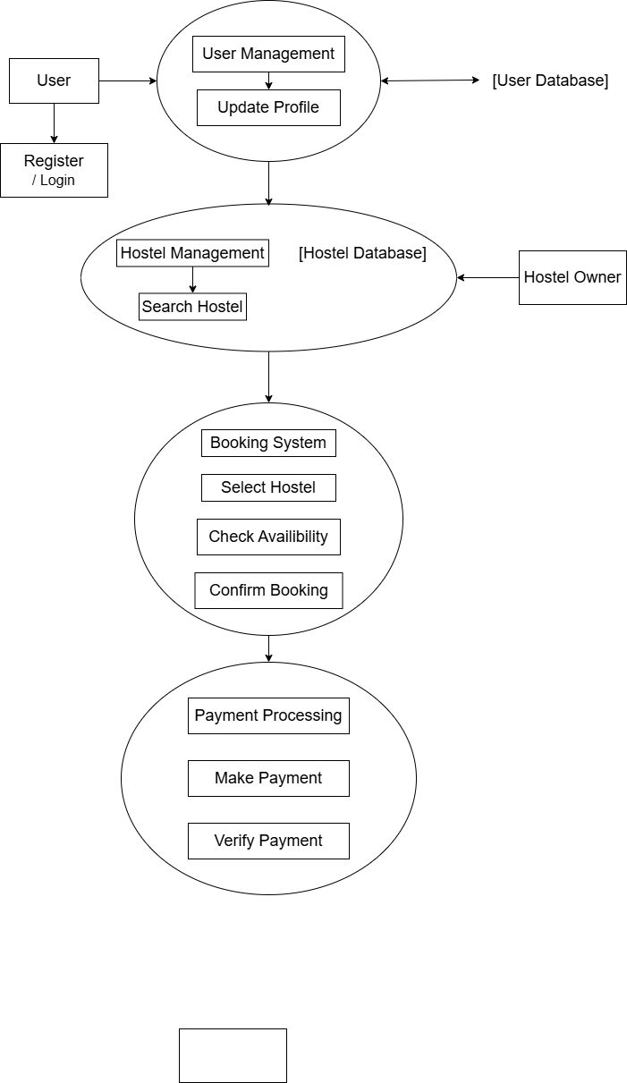
9. Diagram
21
Data Flow Diagram-2

Slide 22
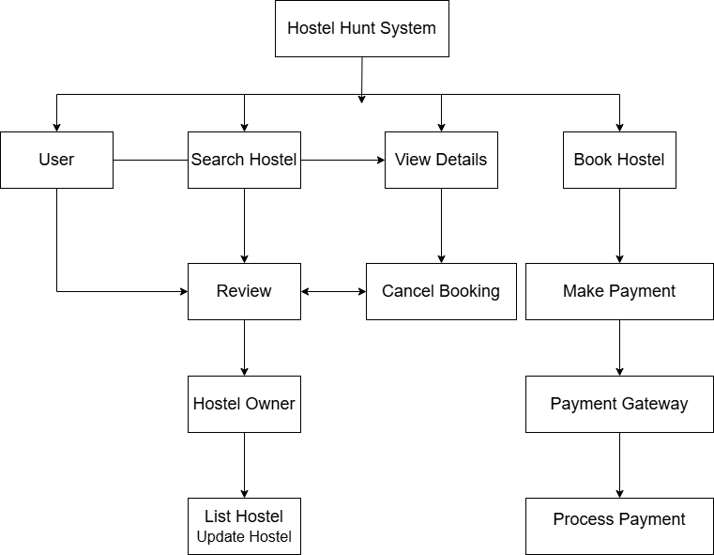
9. Diagram
22
9.4 Activity Diagram

Slide 23
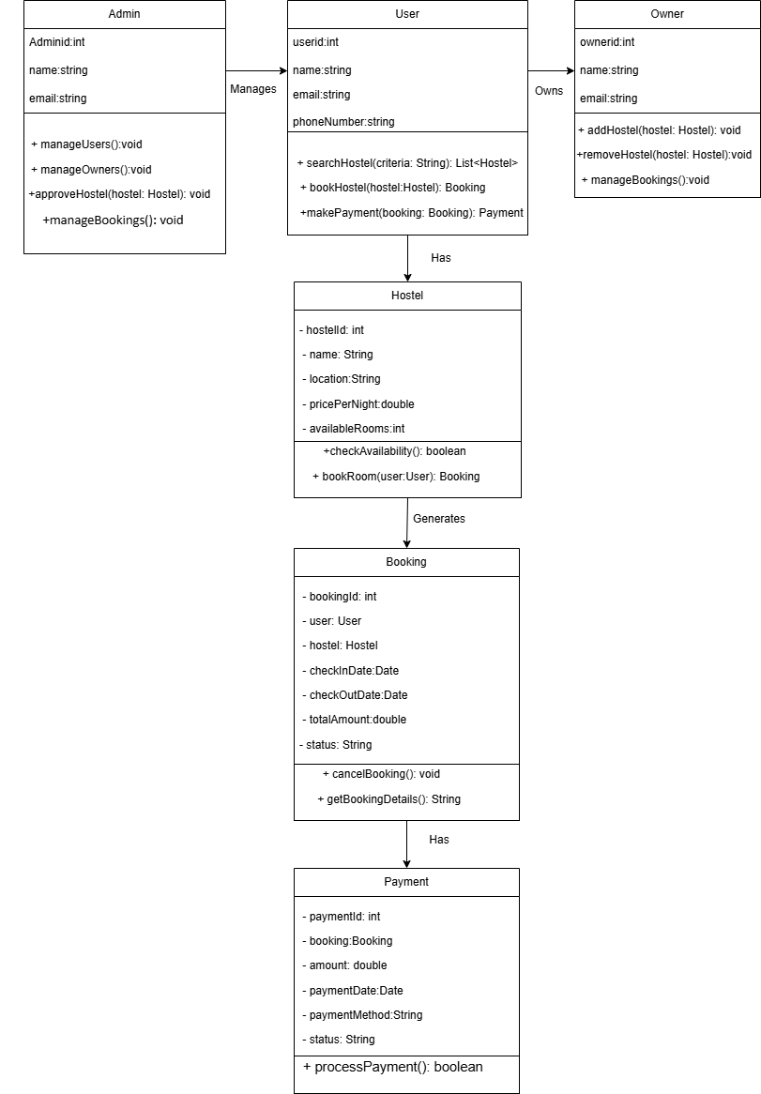
9. Diagram
23
9.5 Class Diagram

Slide 24
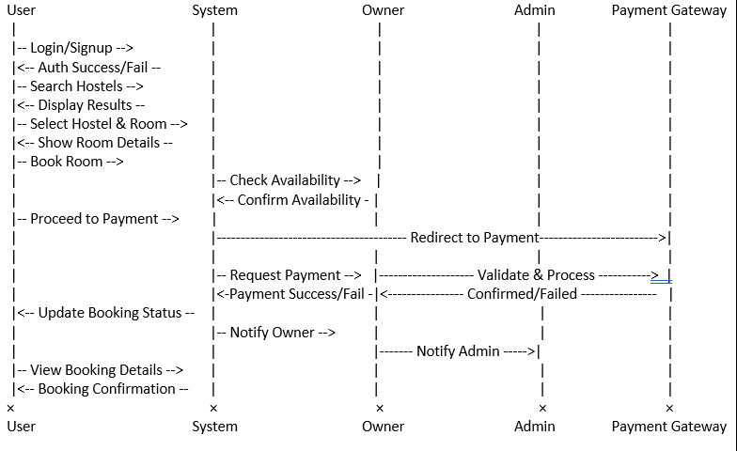
9. Diagram
24
9.6 Sequence Diagram

Slide 25
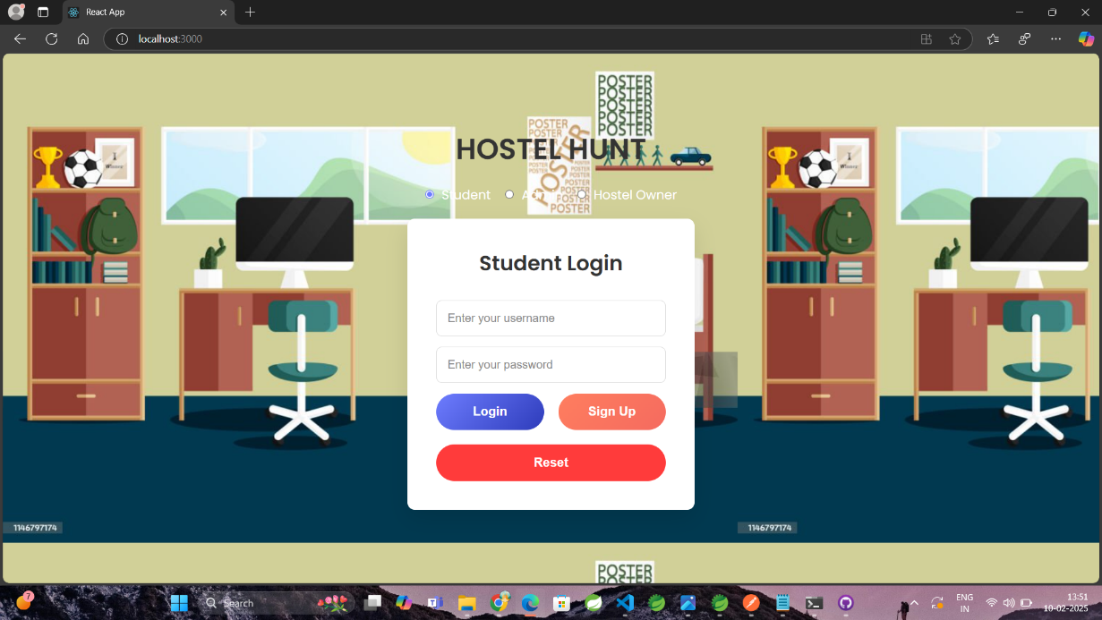
10. Snapshot
25
10.1 Login Page

Slide 26
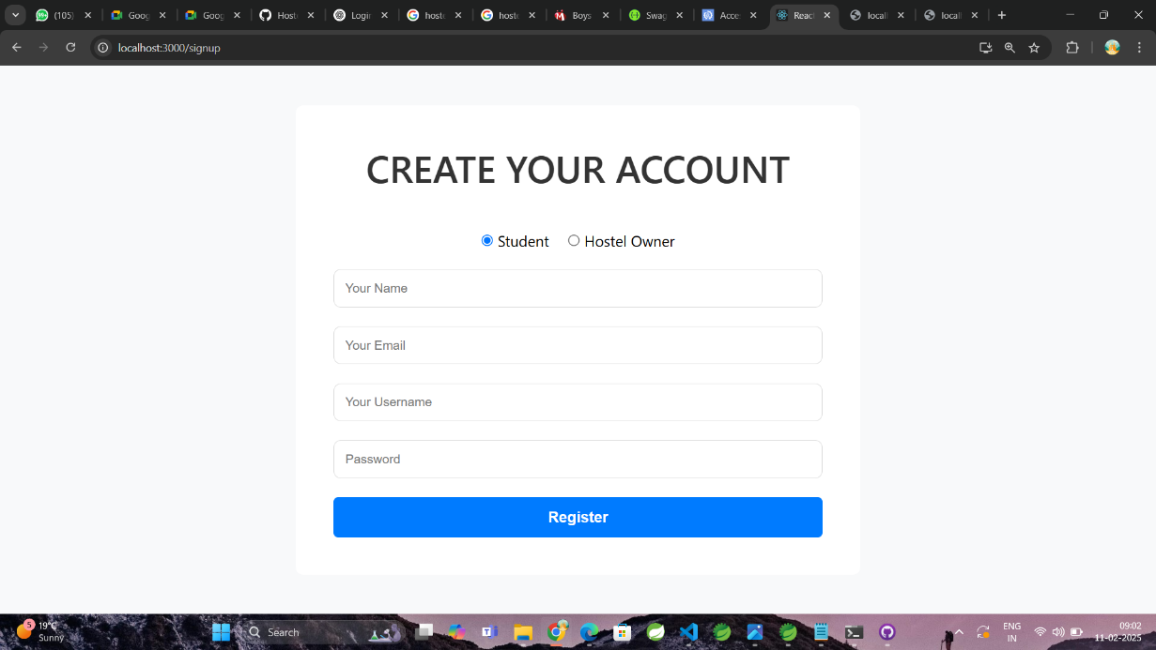
10. Snapshot
26
10.2 Student Register Page

Slide 27
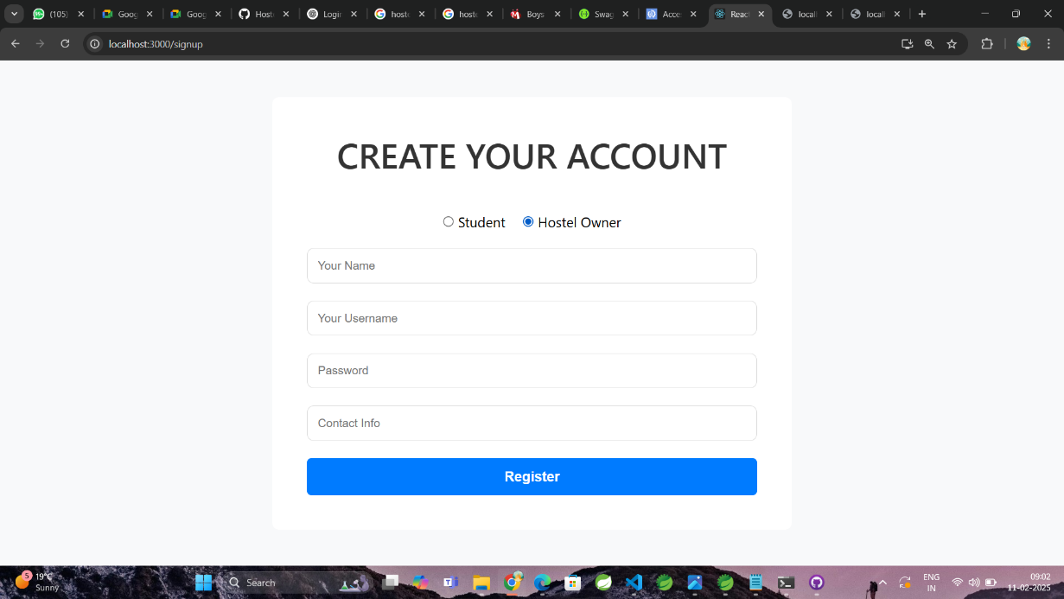
10. Snapshot
27
10.3 Owner Register Page

Slide 28
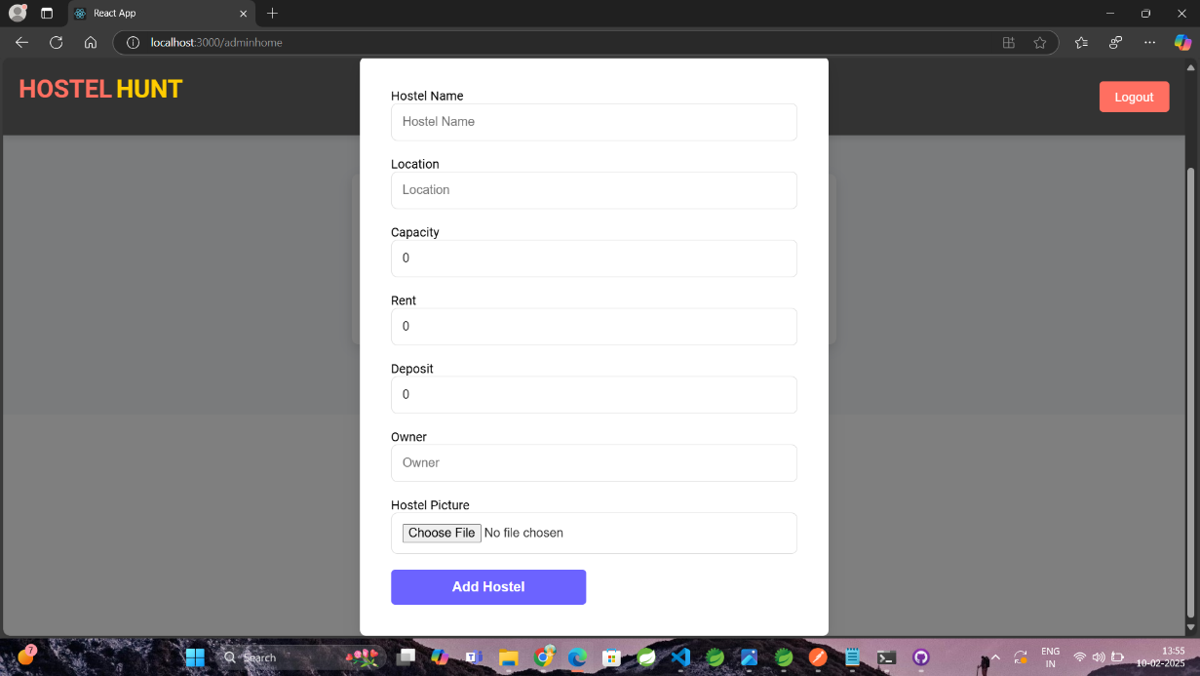
10. Snapshot
28
10.4 Add New Hostel Page

Slide 29
11. Advantage
29
Efficiency: Automates hostel booking and management.
User-Friendly: Provides an intuitive interface for users and owners.
Security: Implements secure authentication and payment transactions.
Scalability: Can accommodate multiple hostels and users.
Transparency: Users can view detailed hostel and booking information.

Slide 30
12. Conclusion
30
The Hostel Hunt System improves efficiency and transparency in hostel booking.
Future enhancements may include AI-powered recommendations, chatbot support, and mobile app integration.

Slide 31
13. Reference
31
React.js Documentation - Official React documentation for frontend development. Available at: https://reactjs.org
Spring Boot Documentation - Official documentation for backend development. Available at: https://spring.io/projects/spring-boot
MySQL Documentation - Database management and SQL queries reference. Available at: https://dev.mysql.com/doc/
Google Maps API - Documentation for location services integration. Available at: https://developers.google.com/maps/documentation
Payment Gateway API - Online transaction processing references. Available from the respective payment providers (e.g., PayPal, Stripe, Razor pay).

Slide 32
32
THANK YOU

